Slide 1





Why UEFI Security Matters
Runs at Ring -2 (highest privilege)
Controls Secure Boot process
Direct access to all hardware
UEFI firmware runs before the operating system loads, creating a critical attack surface that traditional security solutions cannot protect against. Vulnerabilities at this level can lead to persistent malware that survives OS reinstalls and bypasses security measures.
Malware persists across OS reinstalls
Invisible to OS-level security tools

Slide 2
Understanding UEFI
What is UEFI?
UEFI Boot Process
Unified Extensible Firmware Interface - modern replacement for legacy BIOS
1
SEC (Security)
Initial platform startup, CPU reset, chipset initialization
Firmware interface between operating system and platform firmware
2
PEI (Pre-EFI Initialization)
Memory initialization, temporary RAM setup
Provides standardized environment for booting an OS and running pre-boot applications
3
DXE (Driver Execution Environment)
Permanent memory setup, driver dispatching
4
BDS (Boot Device Selection)
UEFI vs. BIOS
Boot policy enforcement, boot option selection
5
RT (Runtime)
Handoff to OS, runtime services available
Security Features
Secure Boot
Measured Boot
TPM Integration
Firmware Authentication
Platform Key Hierarchy
SMM Protections

Slide 3
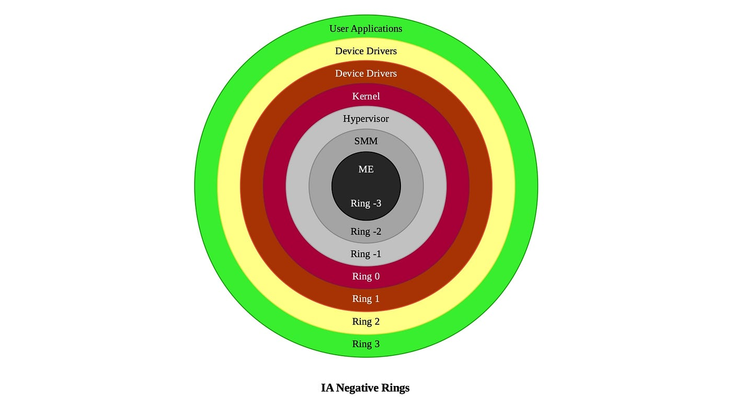
CPU Protection Rings and Privilege Levels
What Are Protection Rings?
Privilege Hierarchy
Hierarchical privilege levels in CPU architecture that enforce access control and protect critical system resources
Lower numbers = higher privilege and more system access
Each ring has restrictions on memory access and CPU instructions
Ring Privileges & Functions
Ring | Privilege | Function
Ring -2 | Highest | System Management Mode (SMM)
Ring -1 | Very High | Hypervisor / VMM
Ring 0 | High | OS Kernel / Drivers
Ring 1 & 2 | Medium | Device Drivers (rarely used)
Ring 3 | Lowest | User Applications
Security Implications
Ring -2 (SMM) operates above OS visibility, making exploits extremely difficult to detect
Compromise at higher privilege rings can bypass all lower-level security controls
SMM code has unrestricted access to all physical memory, hardware, and CPU state

Slide 4
Rootkits and Bootkits
Types of Malicious Kits
UEFI Rootkits & Bootkits
UEFI rootkits represent the most dangerous class of firmware malware, operating at the lowest level of system execution
Rootkits
Bootkits
Malicious software designed to hide its existence while maintaining privileged access
Malware that infects the boot process to load before the operating system
Invisible to OS - operates below operating system visibility
Survives reformatting - persists across OS reinstalls
Firmware Kits
Kernel Kits
Bypasses Secure Boot - can disable security mechanisms
Full system control - complete access to hardware and memory
Malware embedded in UEFI firmware that survives OS reinstallation
Malware operating at Ring 0 with full system access
Persistence Mechanisms
Feature | Rootkits | Bootkits
Activation Time | After OS loads | Before OS loads
Persistence | File system | Boot sector
Detection Difficulty | High | Very High
Removal | OS reinstall | Firmware reflash
UEFI Variable Corruption - Modifying NVRAM variables to maintain persistence
DXE Driver Infection - Infecting UEFI drivers that load during boot
SPI Flash Modification - Directly modifying firmware on flash chip
SMM Code Injection - Exploiting SMM vulnerabilities for execution

Slide 5
System Management Mode (SMM) Security
What is SMM?
Why SMM is a Security Concern
System Management Mode - A special-purpose execution mode in x86 CPUs that operates at the highest privilege level (Ring -2)
Invisible to OS - No visibility or control from operating system
Unrestricted Access - Complete control over all physical memory and hardware
Bypasses Protections - Circumvents OS security, hypervisors, and Secure Boot
Designed to handle system-wide functions like power management and hardware control
Complex Code - Difficult to audit and often contains vulnerabilities
Completely transparent to the OS and all other software
Why Arbitrary Code Execution in SMM is Extremely Dangerous
SMM Purposes
Power Management - Thermal control, fan speed, sleep states
Persistence - Malware survives OS reinstallation and hard drive wipes
Full System Control - Complete access to encryption keys, passwords, and all data
Hardware Control - Emulating missing hardware features
System Management - OEM-specific system functions
Undetectable - Traditional security tools cannot see or remove SMM malware
•
Network Compromise - Can establish covert communication channels
Error Handling - Critical system error recovery
Security Functions - TPM operations, secure boot
SMM exploits can lead to permanent system compromise that can only be resolved by reflashing the firmware with a clean image
SMM Vulnerability Impact

Slide 6
Technical Details
SMM Handler Architecture
Vulnerability Exploitation Flow
SMI Handler Registration
1
Trigger SMI
SMM handlers register to respond to specific System Management Interrupts (SMIs)
Attacker sends specially crafted request via USB/Thunderbolt device to trigger vulnerable SMM handler
SMRAM Protection
2
Overflow VariableName Buffer
Special memory region accessible only in SMM, protected by CPU features
Excessively long VariableName parameter overwrites stack buffer and adjacent memory
Communication Buffer
3
Control SMM Execution
Data exchange mechanism between SMM and non-SMM code
Overwritten return address redirects execution to attacker-controlled code in SMRAM
EFI_STATUS EFIAPI SmmGetVariable ( IN CHAR16 *VariableName, IN EFI_GUID *VendorGuid,
OUT UINT32 *Attributes,
IN OUT UINTN *DataSize, OUT VOID *Data ) // Vulnerable function
4
Escalate Privileges
Malicious code executes with Ring -2 privileges, bypassing all OS security
5
Establish Persistence
Modify UEFI firmware to maintain persistence across reboots and OS reinstalls

Slide 7





Vulnerability Overview
CVE ID:
CVE-2025-27718
Severity:
CVSS 8.8 HIGH
Affected:
Dell + Gigabyte BIOS < 184.108.40.206
Vector:
Physical access required
Technical Trigger
Published:
August 2025
Stack buffer overflow in SmmGetVariable() handler
Exploitable via malicious USB/Thunderbolt device
Stack Buffer Overflow Vulnerability
Allows arbitrary code execution in System Management Mode (SMM)
Insufficient Length Validation
Vulnerability exists in variable name length validation
VariableName length not properly validated before copying to stack buffer
Attacker can overwrite SMI handler execution flow
Unsafe Memory Operations
Using CopyMem() without bounds checking allows overflow
Control Flow Hijacking
Overflow overwrites return address, redirecting execution to attacker's payload

Slide 8






Attack Scenario
1
Initial Access
Impact
Attacker boots target system with crafted USB/Thunderbolt device containing malicious payload
Bypasses Secure Boot and other OS security mechanisms
2
Trigger Vulnerability
Rootkit remains invisible to OS-level security tools
Malicious SMI (System Management Interrupt) triggers stack buffer overflow in SmmGetVariable() handler
Attacker gains full system control with highest privileges
3
Code Execution
Overflow allows arbitrary code execution in System Management Mode (SMM)
Malware persists across OS reinstalls and hard drive wipes
4
Persistence
Potential for data theft and long-term surveillance
Malicious code modifies UEFI firmware to install persistent rootkit that survives OS reinstallation

Slide 9









Detection & Mitigation
Detection Tools
Mitigation Strategies
Binarly IQ
Update BIOS
Commercial firmware scanner that detects SMM vulnerabilities and malicious code patterns
Install Dell BIOS version ≥ 220.127.116.11 or later to patch the vulnerability
CHIPSEC
Enable UEFI Secure Boot
Open-source framework for analyzing platform security including firmware, hardware, and configuration
Prevents unauthorized firmware from loading during boot process
fwupd
Enable SMM Protection
Open-source daemon for managing firmware updates on Linux, includes security checks
Activate SMM_BWP and BIOSWE protection in BIOS settings
Restrict Physical Access
UEFI Scanner
Limit USB/Thunderbolt port access to prevent physical attacks
Analyzes UEFI firmware images for known vulnerabilities and suspicious components
Firmware Attestation
Implement remote attestation to verify firmware integrity

Slide 10









Broader Implications
Industry Impact
Future Trends
Cross-Vendor Vulnerabilities
Pre-OS Security Focus
Similar flaws discovered in Lenovo, HP, and Gigabyte firmware
Enhanced firmware attestation and measurement technologies
Supply Chain Risks
Hardware-Based Protections
Firmware compromised during manufacturing process or distribution
Intel CET and AMD SEV providing stronger isolation
SMM Hardening
Security Erosion
Stricter SMM code signing and privilege separation
Undermines trust in Secure Boot and other firmware protections
Standardized Security
Industry-wide security frameworks for firmware development
Regulatory Scrutiny
Increased government oversight of firmware security practices

Slide 11





Q&A & Resources
Questions?
Additional Resources
Video: "This Goes Deeper Than Your Operating System"
Deep dive into motherboard exploits and UEFI security by Low Level youtube.com/watch?v=BTjj1ILCwRs
Advisory: Binarly BRLY-2025-009
Technical analysis of the SMM memory corruption vulnerability binarly.io/advisories/brly-2025-009
We're here to help
Microsoft: System Management Mode Deep Dive
How SMM isolation hardens the platform against attacks microsoft.com/security/blog/2020/11/12/smm-deep-dive
Feel free to ask any questions about UEFI security, the vulnerability, or mitigation strategies
Tools: CHIPSEC Framework
Open-source platform security assessment framework github.com/chipsec/chipsec

